Slide 1



(a)
Visual
(b)
Newcastle
Utah
Designed component
+
act
atgtatag
tataat
cct … atgtatagcctgtttcgctag … atttttgaa
5’UTR
CDS
promoter
cct
atgtatagcctgtttcgctag
atttttgaa
5’UTR
CDS
Terminator
Shared Collection
Boston
SBOL Core
old
Notes:
The SBOL project has a Core module which defines DNA components and aims to develop a set of extensions which further describe synthetic biological designs.
DNA components define the design of a segment of DNA, in terms of its DNA sequence and specify its sub-components, by annotating the required components which make up the design. This strategy allows us to specify: 1. designs in which the sequence is unknown or already defined; 2. hierarchically composed components; 3. unambiguously define the component type using the Sequence Ontology terms; and 4. group components into Collections for distribution to recipients. We are currently planning several extensions to SBOL, see main text for a description.

Slide 2
Visual
Designed component
act
atgtatag
tataat
cct … atgtatagcctgtttcgctag …
5’UTR
CDS
promoter
cct
atgtatagcctgtttcgctag
5’UTR
CDS
Terminator
Shared Collection
SBOL Core
Jake: This figure is confusing because the lines are all undirected and homogeneous. Other suggestions: - lightly shade the background of the top SBOLv part differently than the background of the bottom SBOL Cote part - let the terminator have an unspecified sequence, to demonstrate that capability
Notes:
The SBOL project has a Core module which defines DNA components and aims to develop a set of extensions which further describe synthetic biological designs.
DNA components define the design of a segment of DNA, in terms of its DNA sequence and specify its sub-components, by annotating the required components which make up the design. This strategy allows us to specify: 1. designs in which the sequence is unknown or already defined; 2. hierarchically composed components; 3. unambiguously define the component type using the Sequence Ontology terms; and 4. group components into Collections for distribution to recipients. We are currently planning several extensions to SBOL, see main text for a description.

Slide 3
SBOL Visual
Designed DNA Component
act
atgtatag
tataat
cct … atgtatagcctgtttcgctag …
5’UTR
CDS
tgac
Promoter
5’UTR
cct
atgtatagcctgtttcgctag
gtgactga
5’UTR
CDS
Terminator
CDS
Shared Collection
Collection
SBOL Core
Notes:
The SBOL project has a Core module which defines DNA components and aims to develop a set of extensions which further describe synthetic biological designs.
DNA components define the design of a segment of DNA, in terms of its DNA sequence and specify its sub-components, by annotating the required components which make up the design. This strategy allows us to specify: 1. designs in which the sequence is unknown or already defined; 2. hierarchically composed components; 3. unambiguously define the component type using the Sequence Ontology terms; and 4. group components into Collections for distribution to recipients. We are currently planning several extensions to SBOL, see main text for a description.

Slide 4



SBPkb
Parts Repository
+
Designed four expression cassettes. Choice of RBS and terminator components left unspecified.
pIKE
Washington
pTAK
with types
+
6x
Generated four variant designs of each cassette completing sequence using six RBS and six terminators
Boston
4x pIKE
4x pTAK
Combined and simulated sixteen variant designs of each complete toggle switches
16x pIKE
Utah
16x pTAK
16x pIKE
Codon optimized the CDS and xx regions.
16x pTAK
Life Technologies
(Carlsbad, CA beach icon?)
Design files stored in JBEI repository. Design and SBML model in Newcastle.
Newcastle
Joint BioEnergy Institute
Notes:
The SBOL project has a Core module which defines DNA components and aims to develop a set of extensions which further describe synthetic biological designs.
DNA components define the design of a segment of DNA, in terms of its DNA sequence and specify its sub-components, by annotating the required components which make up the design. This strategy allows us to specify: 1. designs in which the sequence is unknown or already defined; 2. hierarchically composed components; 3. unambiguously define the component type using the Sequence Ontology terms; and 4. group components into Collections for distribution to recipients. We are currently planning several extensions to SBOL, see main text for a description.

Slide 5
SBPkb
Parts Repository
current demo
+
Designed four expression cassettes. Choice of RBS and terminator components left unspecified.
pIKE
Washington
pTAK
+
6x
Generated four variant designs of each cassette completing sequence using six RBS and six terminators
Boston
4x pIKE
4x pTAK
Combined and simulated sixteen variant designs of each complete toggle switches
16x pIKE
Utah
16x pTAK
opt
opt
16x pIKE
Codon optimized the CDS and xx regions.
opt
opt
opt
16x pTAK
Life Technologies
(Carlsbad, CA beach icon?)
opt
Design files stored in JBEI repository. Design and SBML model in Newcastle.
Newcastle
Joint BioEnergy Institute
Notes:
The SBOL project has a Core module which defines DNA components and aims to develop a set of extensions which further describe synthetic biological designs.
DNA components define the design of a segment of DNA, in terms of its DNA sequence and specify its sub-components, by annotating the required components which make up the design. This strategy allows us to specify: 1. designs in which the sequence is unknown or already defined; 2. hierarchically composed components; 3. unambiguously define the component type using the Sequence Ontology terms; and 4. group components into Collections for distribution to recipients. We are currently planning several extensions to SBOL, see main text for a description.

Slide 6
SBPkb
Parts Repository
+
Designed four expression cassettes. Choice of RBS and terminator components left unspecified.
pIKE
Washington
pTAK
+
6x
Generated four variant designs of each cassette completing sequence using six RBS and six terminators
Boston
4x pIKE
4x pTAK
opt
opt
opt
16x pIKE
Codon optimized the CDS and xx regions.
opt
opt
opt
16x pTAK
Life Technologies
(Carlsbad, CA beach icon?)
proposed
change
Combined and simulated sixteen variant designs of each complete toggle switches
opt
opt
16x pIKE
opt
16x pTAK
opt
opt
Utah
opt
Design files stored in JBEI repository. Design and SBML model in Newcastle.
Newcastle
Joint BioEnergy Institute
Notes:
The SBOL project has a Core module which defines DNA components and aims to develop a set of extensions which further describe synthetic biological designs.
DNA components define the design of a segment of DNA, in terms of its DNA sequence and specify its sub-components, by annotating the required components which make up the design. This strategy allows us to specify: 1. designs in which the sequence is unknown or already defined; 2. hierarchically composed components; 3. unambiguously define the component type using the Sequence Ontology terms; and 4. group components into Collections for distribution to recipients. We are currently planning several extensions to SBOL, see main text for a description.

Slide 7






SBPkb
Parts Repository
+
Designed four expression cassettes. Choice of RBS and terminator components left unspecified.
pIKE
Washington
pTAK
+
6x
Generated four variant designs of each cassette completing sequence using six RBS and six terminators
Boston
4x pIKE
4x pTAK
opt
opt
opt
4x pIKE
Codon optimized the CDS and xx regions.
opt
opt
opt
4x pTAK
Life Technologies
Combined and simulated sixteen variant designs of each complete toggle switches
opt
opt
16x pIKE
opt
16x pTAK
opt
opt
Utah
opt
Design files stored in JBEI repository. Designs and SBML models are stored in Newcastle.
Newcastle
Joint BioEnergy Institute
Notes:
The SBOL project has a Core module which defines DNA components and aims to develop a set of extensions which further describe synthetic biological designs.
DNA components define the design of a segment of DNA, in terms of its DNA sequence and specify its sub-components, by annotating the required components which make up the design. This strategy allows us to specify: 1. designs in which the sequence is unknown or already defined; 2. hierarchically composed components; 3. unambiguously define the component type using the Sequence Ontology terms; and 4. group components into Collections for distribution to recipients. We are currently planning several extensions to SBOL, see main text for a description.

Slide 8
+
SBPkb
Designed four expression cassettes, leaving RBS and terminator components unspecified.
pIKE
repressor
repressor
reporter
Washington
pTAK
repressor
repressor
reporter
+
iGEM / [ref#]
Generated four variant designs of each cassette using six RBS and six terminator components.
Boston
4x pIKE
4x pTAK
Assembled and modeled sixteen variant designs of the toggle switch.
16x pIKE
16x pTAK
Utah
Life Technologies
Newcastle
Joint BioEnergy Institute
Received design file for codon optimization and gene synthesis.
Stored design and model files in repository for dissemination.
Stored design files in repository for dissemination.

Slide 9
Supplementary Figure 2.
Seattle
Stanford
Anaheim
Blacksburg
San Diego
Seattle
San Francisco
Boston
Newcastle
?
2008
2009
2010
2011
2012
2013

Slide 11
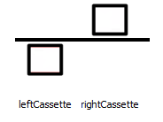
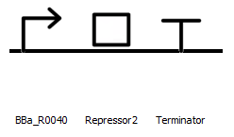
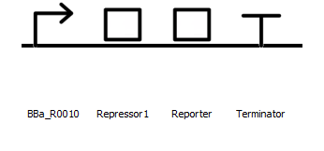
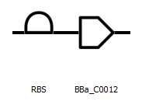
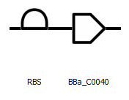
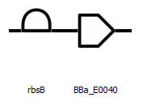
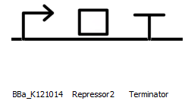
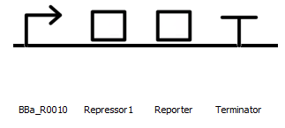
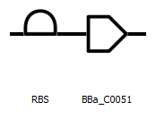
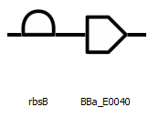
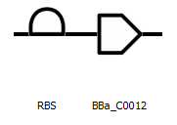
Template
left Cassette
right Cassette
pIKE
Repressor2
Repressor1
Reporter
left Cassette
right Cassette
pTAK
Repressor2
Repressor1
Reporter

Slide 12
Context
System
Model
Device
Interaction
Sequence Annotation
Component
Participant
Sequence
Deprecated!

Slide 13
Context
System
Model
0..*
1
0..*
0..*
Device
Interaction
0..*
1..*
0..*
Sequence Annotation
Component
Participant
1
0..1
Sequence

Slide 14
Context
System
Model
Device
Interaction
Sequence Annotation
Component
Participant
Sequence

